Slide 1


World Happiness Report - Analysis
Meenakshi Shankara
DSC680 – Bellevue university
Summer 2023
Notes:
Today I would like to present our findings in a predictive analytics on the World Happiness Report based set number of factors.

Slide 2
Summary
Introduction
Data
Modeling
Takeaways
Assumptions and Ethical matters
References
Notes:
I will be covering a brief about the project, go over data and a

Slide 3

Introduction
The World Happiness Report is a landmark survey of the state of global happiness. The reports review the state of happiness in the world today and show how the new science of happiness explains personal and national variations in happiness. The report contains articles and rankings of national happiness, based on respondent ratings of their own lives, which the report also correlates with various (quality of) life factors.
As the title says, the World Happiness report gives happiness scores and ranking for each of the countries. This provides a valuable insight into the least and most happy countries and what contributes to their rankings. This research is my attempt to dig a little more into what contributes to general happiness and do the factors on which the survey was conducted indeed are factors to one’s happiness.

Slide 4

DATA
The dataset that is being considered for this analysis is extracted from Kaggle website.
The first report was published in 2012, the second in 2013, the third in 2015, and the fourth in the 2016 Update. World Happiness 2017, which ranks 155 countries by their happiness levels, was released at the United Nations at an event celebrating International Day of Happiness on March 20th.
For our analysis we will be considering the datasets for years 2015 - 2019.
DATA DICTIONARY -
Country or region
Overall rank: Rank of countries based on the Happiness Score
Score: A metric measured in terms of rating happiness on a scale of 0 to 10 where 10 is the happiest.
GDP per capita
Social support
Healthy life expectancy
Freedom to make life choices
Generosity
Perceptions of corruption

Slide 5

DATA PREPARATION
The merged dataset has about 781 entries in total
The below transformations will be done on the dataset –
Removed column Dystopia Residual, as it is not available in all datasets and is not a significant factor affecting the Happiness score.
Rename columns for better appeal, understanding and to keep the names consistent across all years.
Add the Year column to differentiate the datasets.
Investigate the missing values in columns and remove them from the data frame.

Slide 6
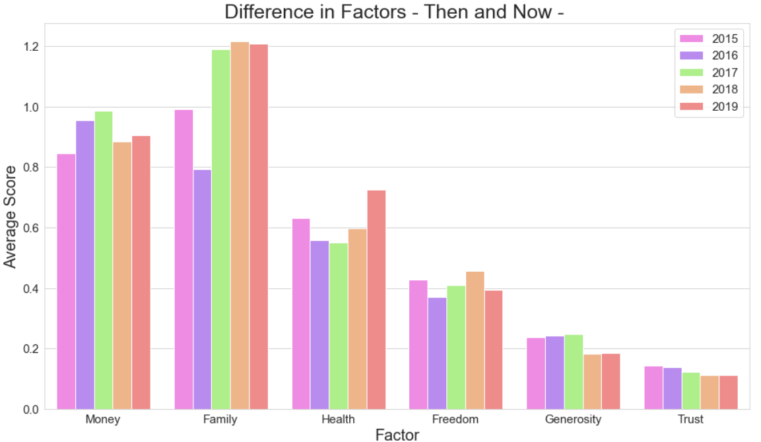
DATA VISUALIZATION
– Impact of Factors over the years
Notes:
the average value for each factor is calculated, factors being GDP per capita, Social Support, Healthy Life Expectancy, Freedom, Generosity, Perceptions of corruption. This will provide a view of which factor impacted the most for each year.
Overall, it seems like the year 2019 had more influence on the happiness score in factors like GDP and Family support. The year 2016 seems to have had lesser average scores in most factors.

Slide 7
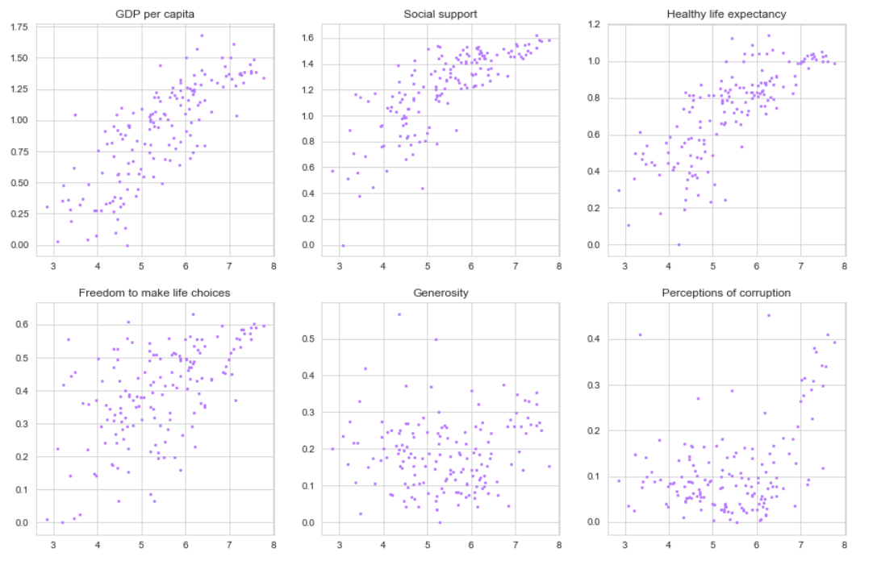
Rank vs Factors – 2019
GDP, Social Support, Healthy Life expectancy have a positive impact on the score.
To an extent Freedom also have a positive impact. Perception of corruption seems to have an impact.
Notes:
Next, plotting the value of each factor against the overall rank will provide a view of where the density of the values lay.
From the scatterplots we can see that GDP, Social Support, Healthy Life expectancy have a positive impact on the score.
To an extent Freedom also have a positive impact. Perception of corruption seems to have an impact. Maybe we need more data or better survey results to see a significant pattern. Generosity does not seem to impact the happiness score. Again, we may need more data for further analysis.

Slide 8
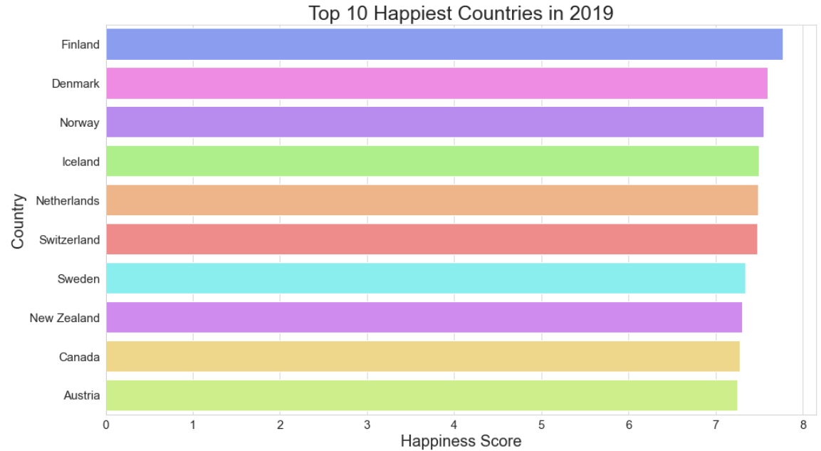
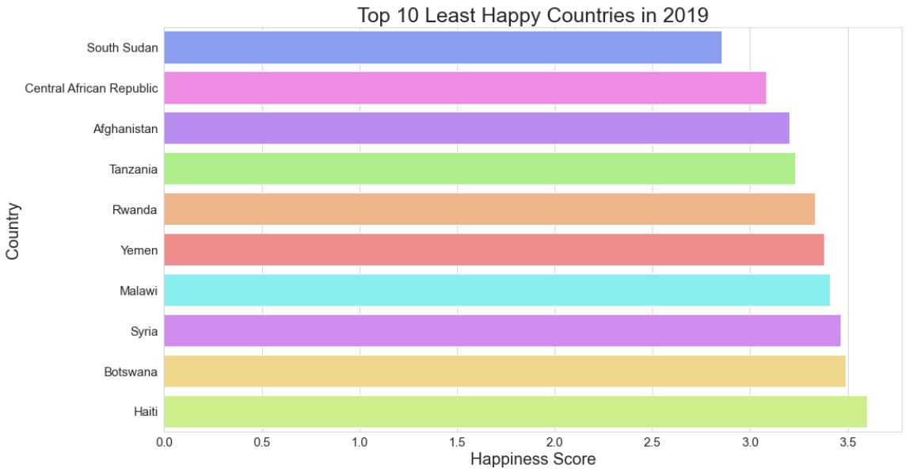
HAPPINESS SCORES - 2019
Who is the happiest and who is not?
Finland, Denmark, and Norway lead the way on overall happiness scores.
South Sudan, Central African Republic, Afghanistan are observed to have the least happiness scores.
Notes:
Based on the scores for each country, we can plot the Top 10 and Least 10 Happiest countries recorded in the year 2019.

Slide 9
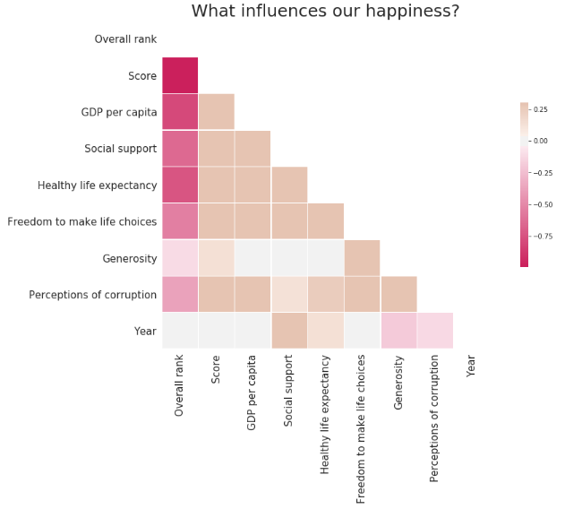
Factors that influence our happiness
GPD Per capita
Good Health and life expectancy
Freedom of choice
And Societal support system
Notes:
Next, we calculate the correlation between each the happiness score with each factor and create a heat map on the correlation values.
We can see the Happiness score is most influenced by GDP and Good Health. There is also a positive correlation between Happiness, Freedom, and social support. Next is the perceptions of corruption. The happiness of a country seems to be least influenced by generosity among its citizens.

Slide 10
Model | Definition | Pros | Cons
Linear Regression | computes the linear relationship between a dependent variable and one or more independent features | simple to implement and easier to interpret the output coefficients | the assumption of linearity between the dependent variable and the independent variables
Decision Tree | A series of sequential decisions made to reach a specific result | Interpretability, no need for feature scaling, works on both linear/nonlinear problems | Poor results on small datasets, overfitting can easily occur
Random Forest | A forest of randomly created decision trees, a combined output of individual decision trees to generate the final output. | Powerful and accurate, good performance on many problems including nonlinear | No interpretability, overfitting can easily occur, need to choose the number of trees
Bayesian Linear | employs prior belief or knowledge about the data to “learn” more about it and create more accurate predictions. | ideal choice when the data is complex or ambiguous | difficult to work with large datasets, takes longer to train the data
PREDICTIVE MODELING

Slide 11
Modeling
The following modeling techniques are used to determine which modeling technique works best on this dataset and the features that are mostly related or correlated to the happiness score.
Linear Regression
Random Forest Regressor
Decision Tree
Bayesian Linear
Linear Regression and the Bayesian Ridge models performed the best for prediction of the Happiness scores.
Model | Score | MAE
Linear Regression | 82.98% | 0.3769
Random Forest | 82.8% | 0.3658
Decision Tree | 69.76% | 0.5034
Bayesian Linear | 83.24% | 0.3723
Notes:
From the Model score and Mean Average Error score, we see Bayesian Ridge has performed better than the other models with 83.24%. Next comes Linear Regression and Random Forest modeling methods with 82.98% and 82.54% respectively. The decision tree has not fared well; therefore, it may not be a good fit for this data analysis.

Slide 12

KEY TAKEAWAYS
What influences our general well-being?
Financial well-being, in terms of GDP per capita
Next is General health and long-life expectancy of the citizens. This translates to availability of medical care and attention.
Freedom of expression and human rights is one of the top factors for happiness.
The gap between the happiest and the least happy country is significantly huge.
A few observations that are not direct -
People who move to happier countries could become happier by association as they blend in that society
Smaller countries are happier than the larger countries. This may mean the governance should focus on smaller regions to make significant changes to the country in whole.

Slide 13

ASSUMPTIONS
The first assumption is that the dataset sample is significant enough to determine the happiness score of a country. According to the World Happiness report, about 1000 entries per country were considered for calculating the score.
The Second assumption is that the factors listed indeed impact the overall happiness/well-being of a country. While they do have significant weightage, happiness is a complex emotion that may depend on multitude of factors that have not been considered in the survey.

Slide 14

ETHICAL ASSESSMENT
One of the ethical considerations for this project is the consideration of results from the analysis in decision-making. Some of the conclusions made from this project’s study could be incorrect or misrepresented due to insufficient or incorrect data. So, while sharing the outcome of this project to a larger audience, the underlying assumptions and data considerations should be shared.
1. No PII Data has been used for the analysis
2. All data sources are extracted from public domains, shared by organizations for educational purposes
3. All references are listed

Slide 15

REFERENCES
World Happiness Report | Kaggle
A Structural Model of the World Happiness Report | R-bloggers
4 Takeaways From This Year’s World Happiness Report (forbes.com)

